Slide 1
Adham Ashraf Saeed
Assignment 1 (Power BI)

Slide 2
Objective
Clean and prepare the provided dataset, then build an interactive and visually appealing Power BI dashboard that provides meaningful insights into the data and presents key findings in a clear and professional way.

Slide 3
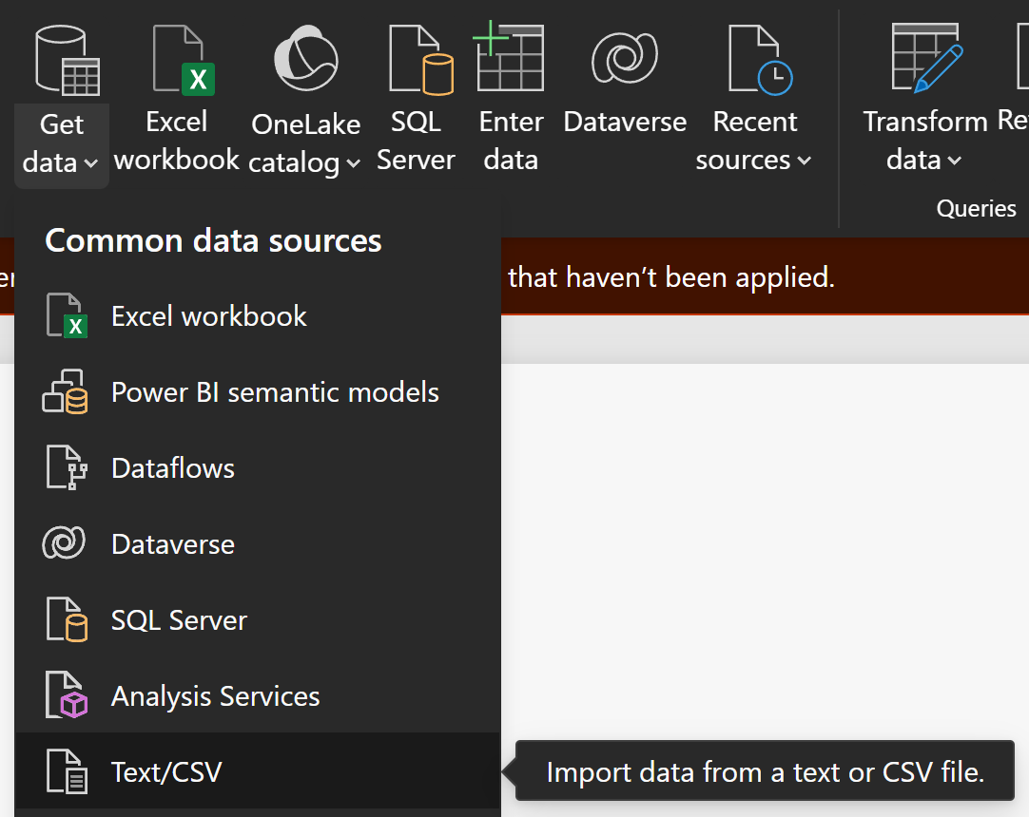
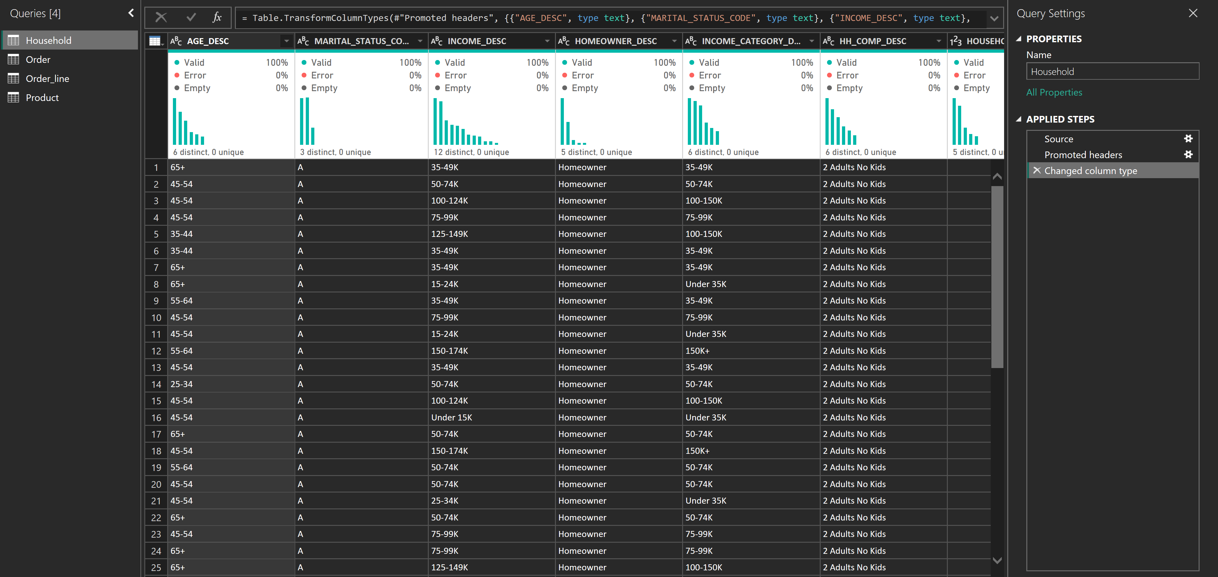
Import Data

Slide 4
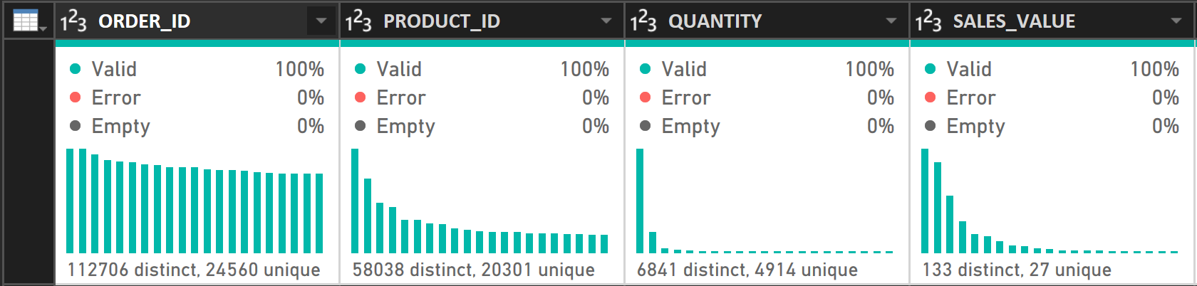
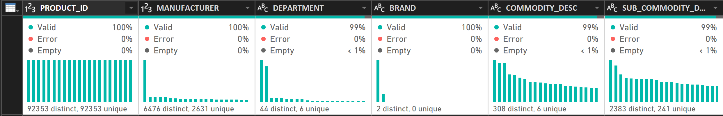
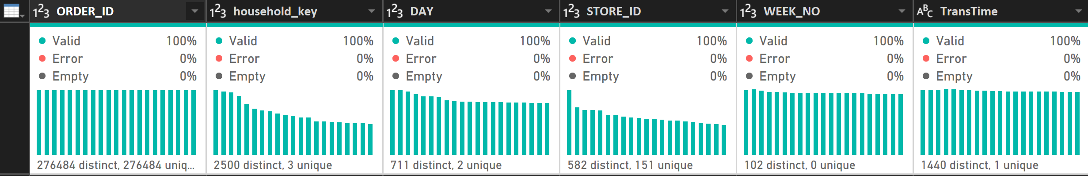
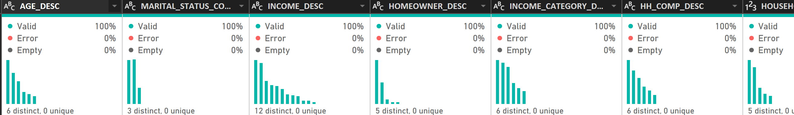
Clean Data

Slide 5
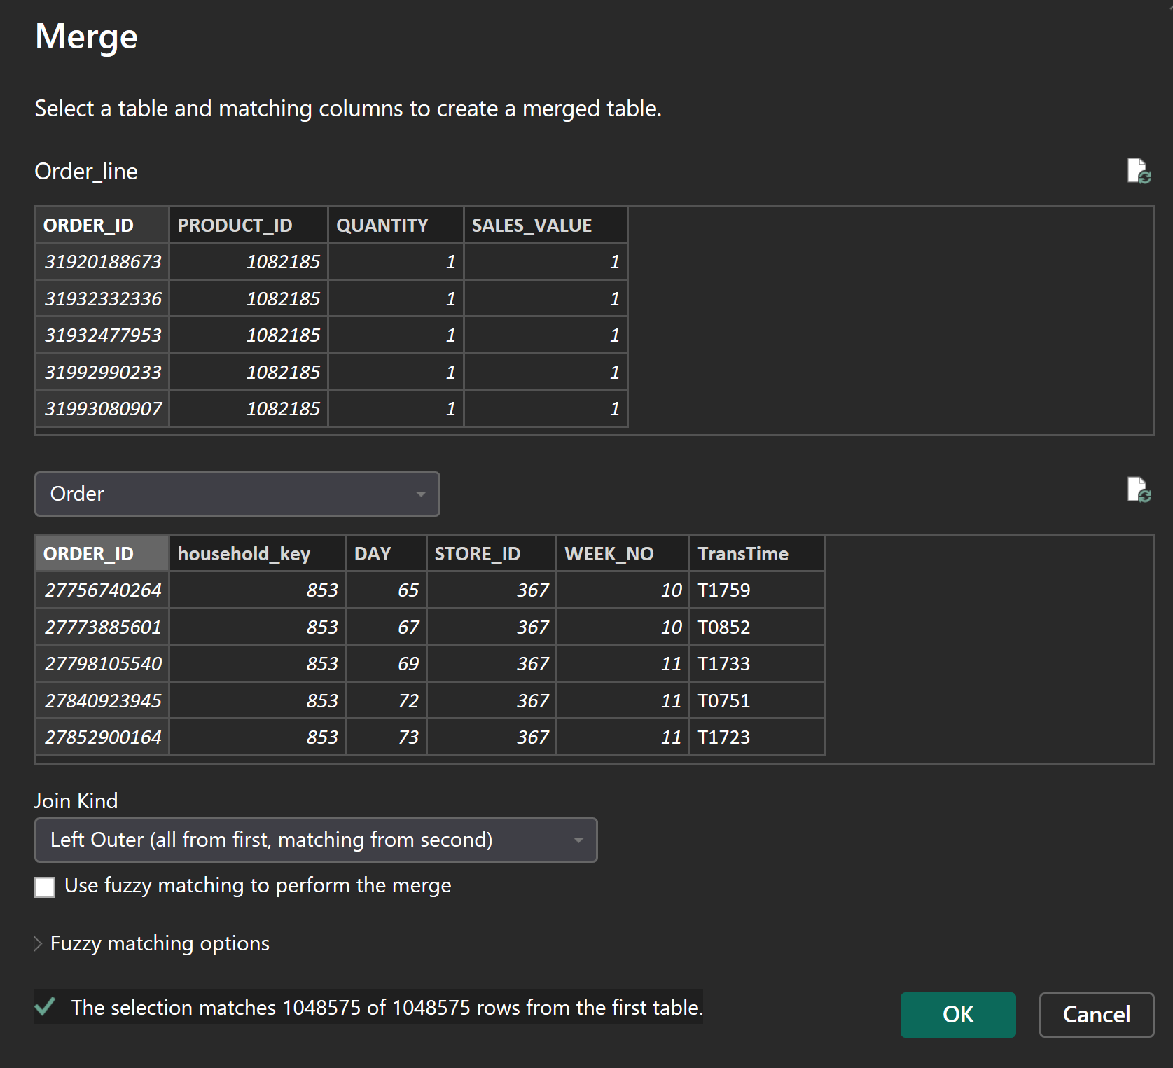
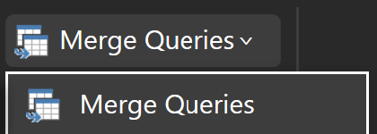
Merge Orders

Slide 6
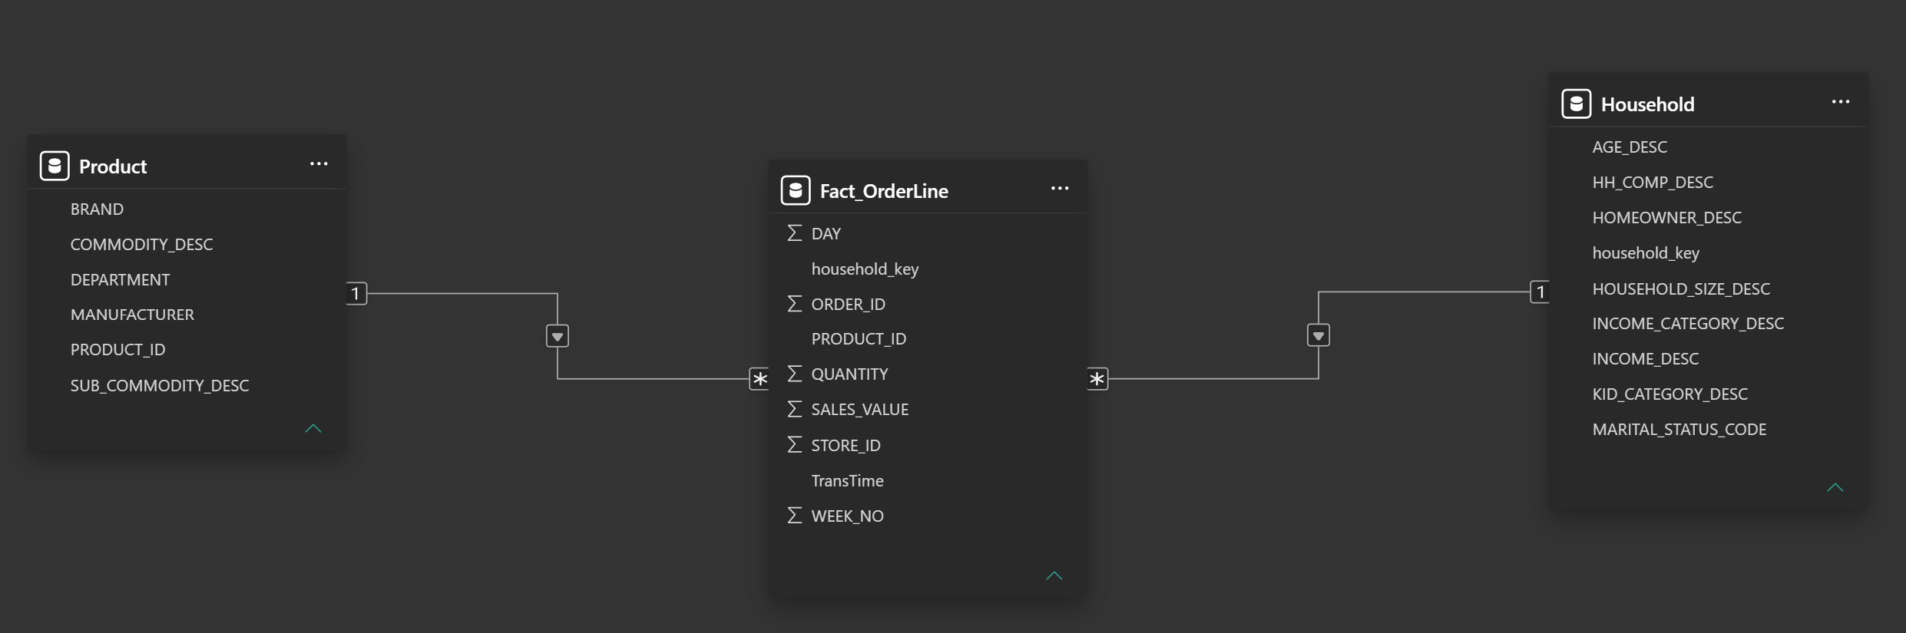
Data Modeling

Slide 7
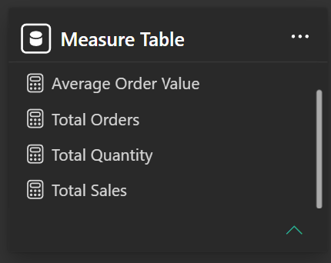
Create Measures

Slide 8

Figma Design Dashboard

Slide 9
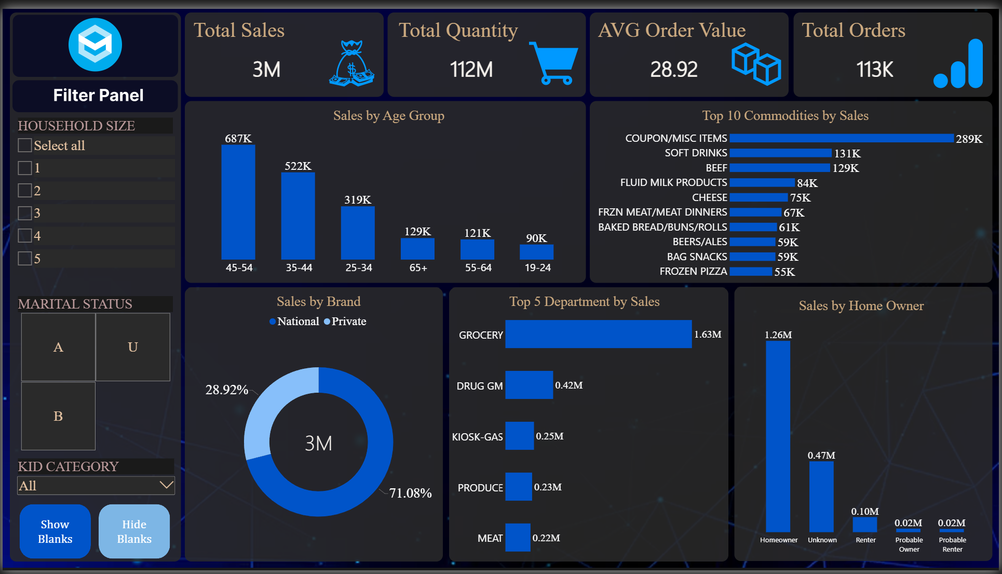
Final Dashboard

